Slide 1

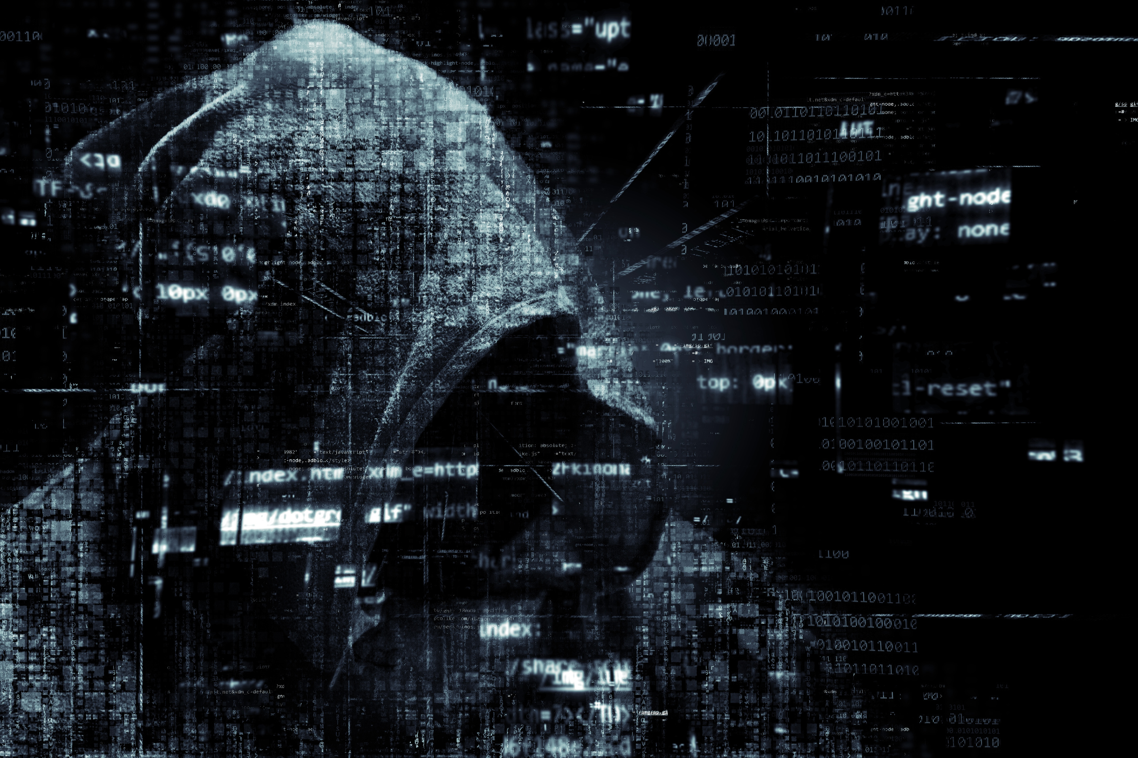
TECH TIDE

Slide 2
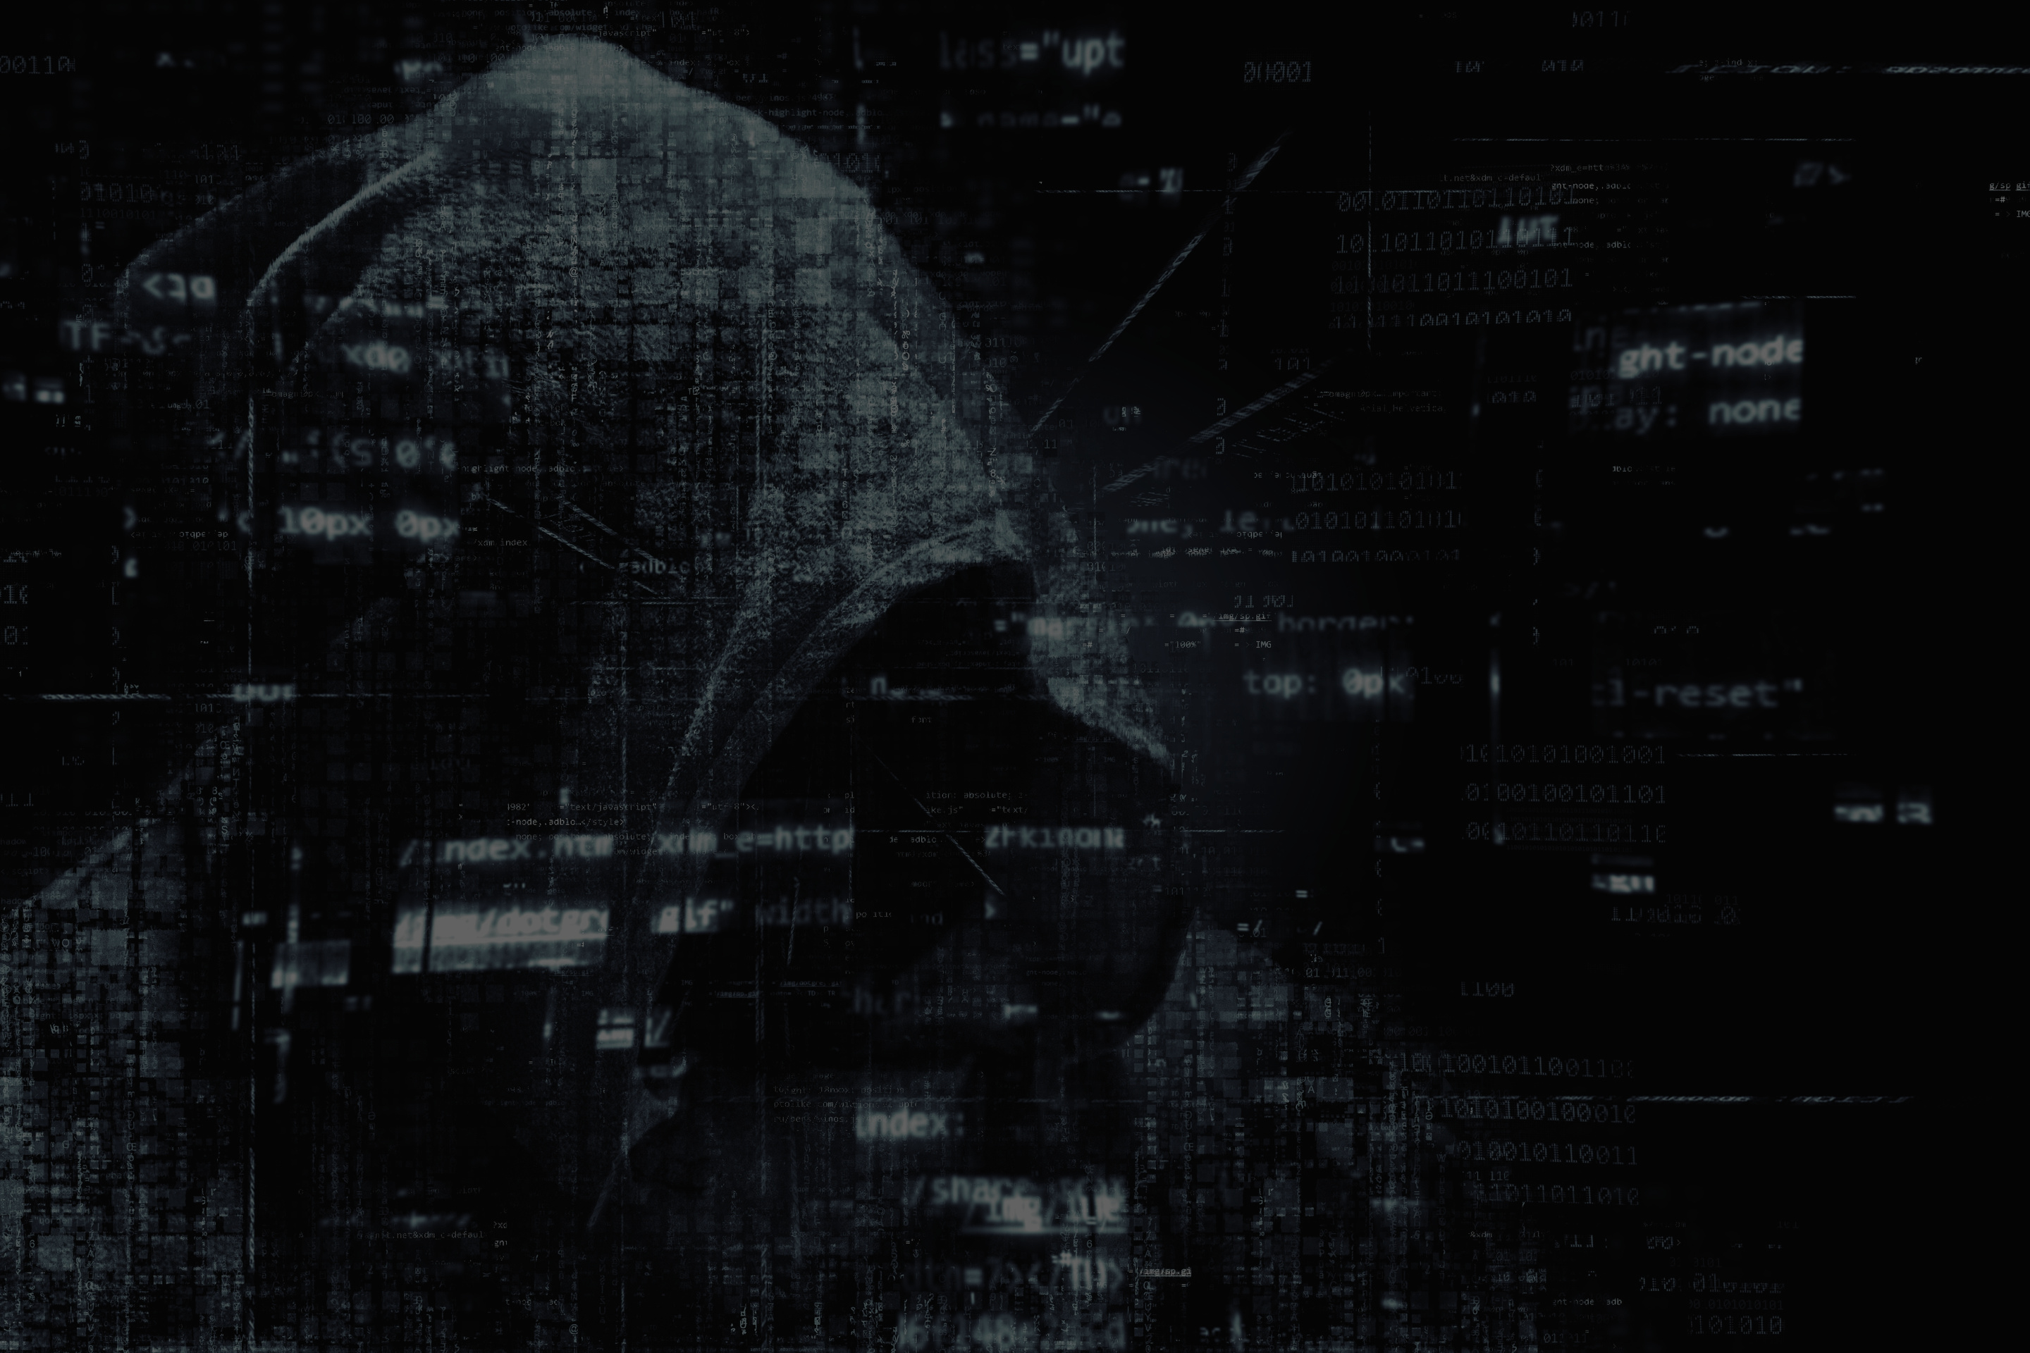
PROBLEM
STATEMENT
India generates 1.75M+ tonnes of e-waste annually, but fear of data breaches keeps many devices unused or discarded unsafely. Existing wiping tools are costly, complex, and lack proof, causing over ₹50,000 crore worth of IT assets to be hoarded. A simple, secure, and verifiable data wiping solution is urgently needed to enable safe recycling and reuse.
PROBLEM STATEMENT ID : 25070
ORGANIZATION : MINISTRY OF MINES

Slide 3
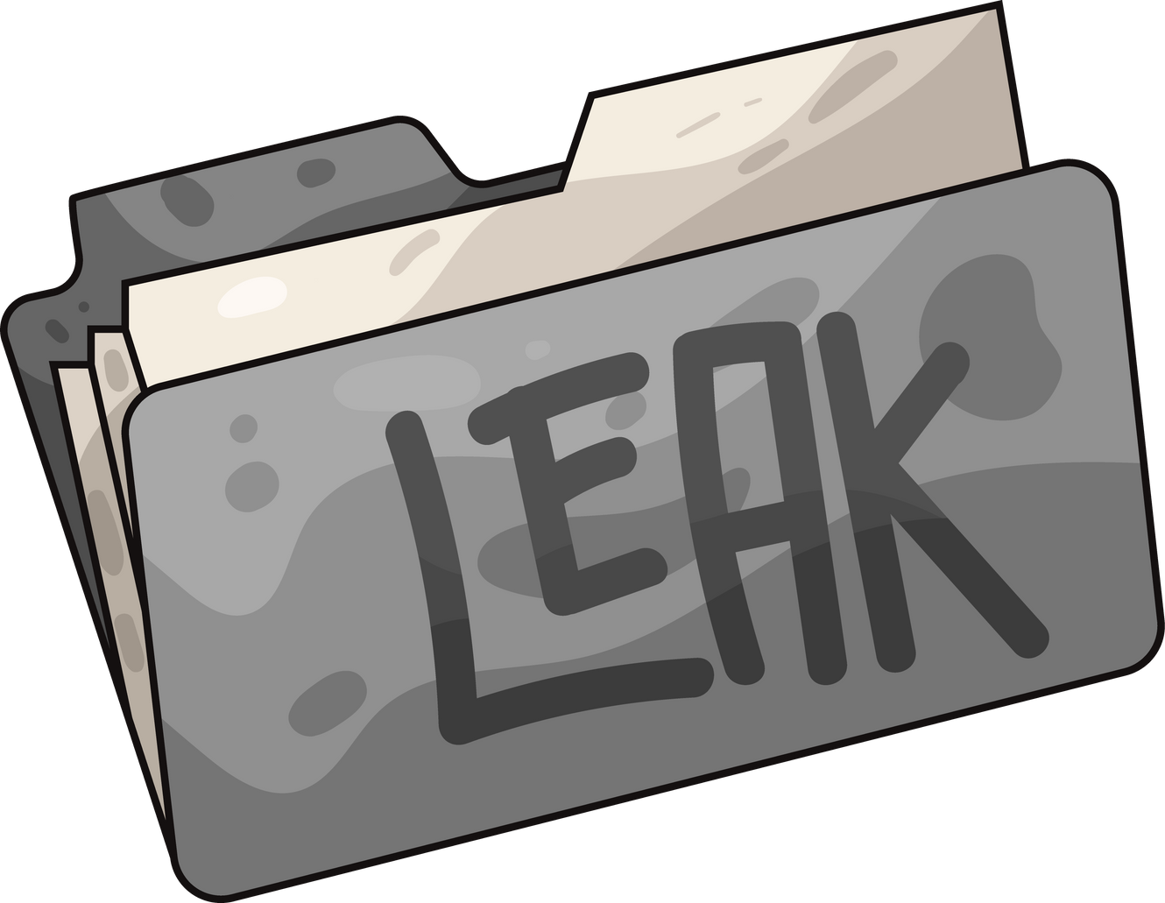
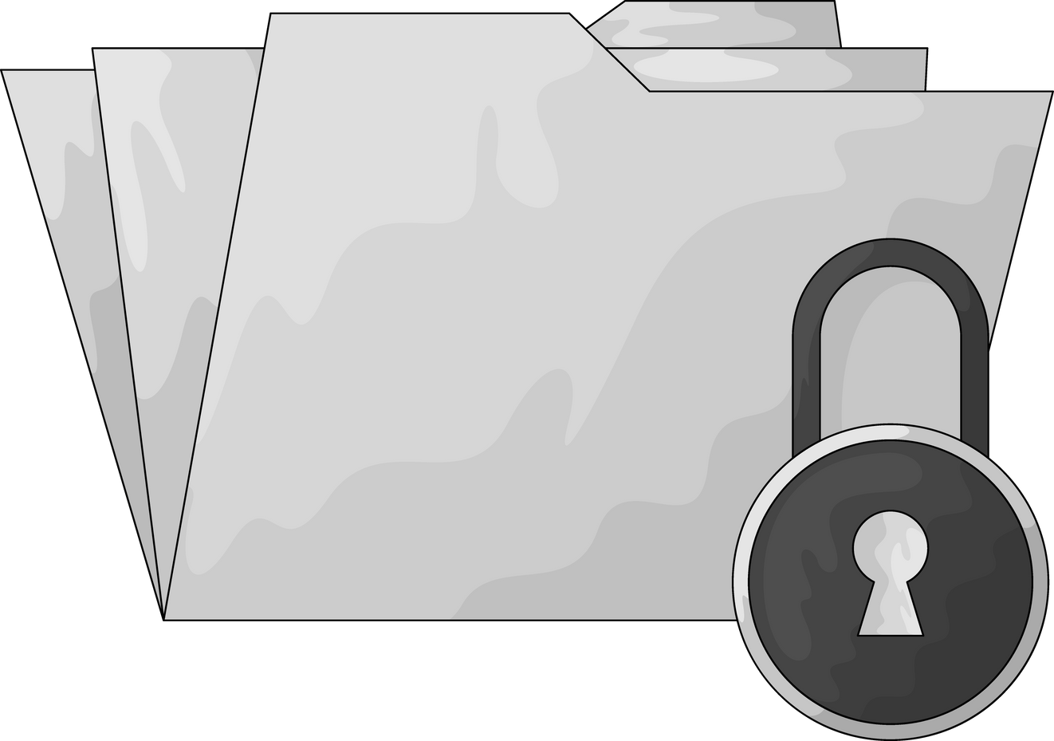
RISK ZONES
(CLEAR THREAT VIBES)
LAW FIRMS - CONFIDENTIAL CASE FILES & CONTRACTS
HOSPITALS - PATIENT RECORDS & SCANS
BANKS - ACCOUNTS & TRANSACTION DATA
SELLING OLD LAPTOPS/ PHONES - HIDDEN PHOTOES, CHATS, PASSWORDS

Slide 4
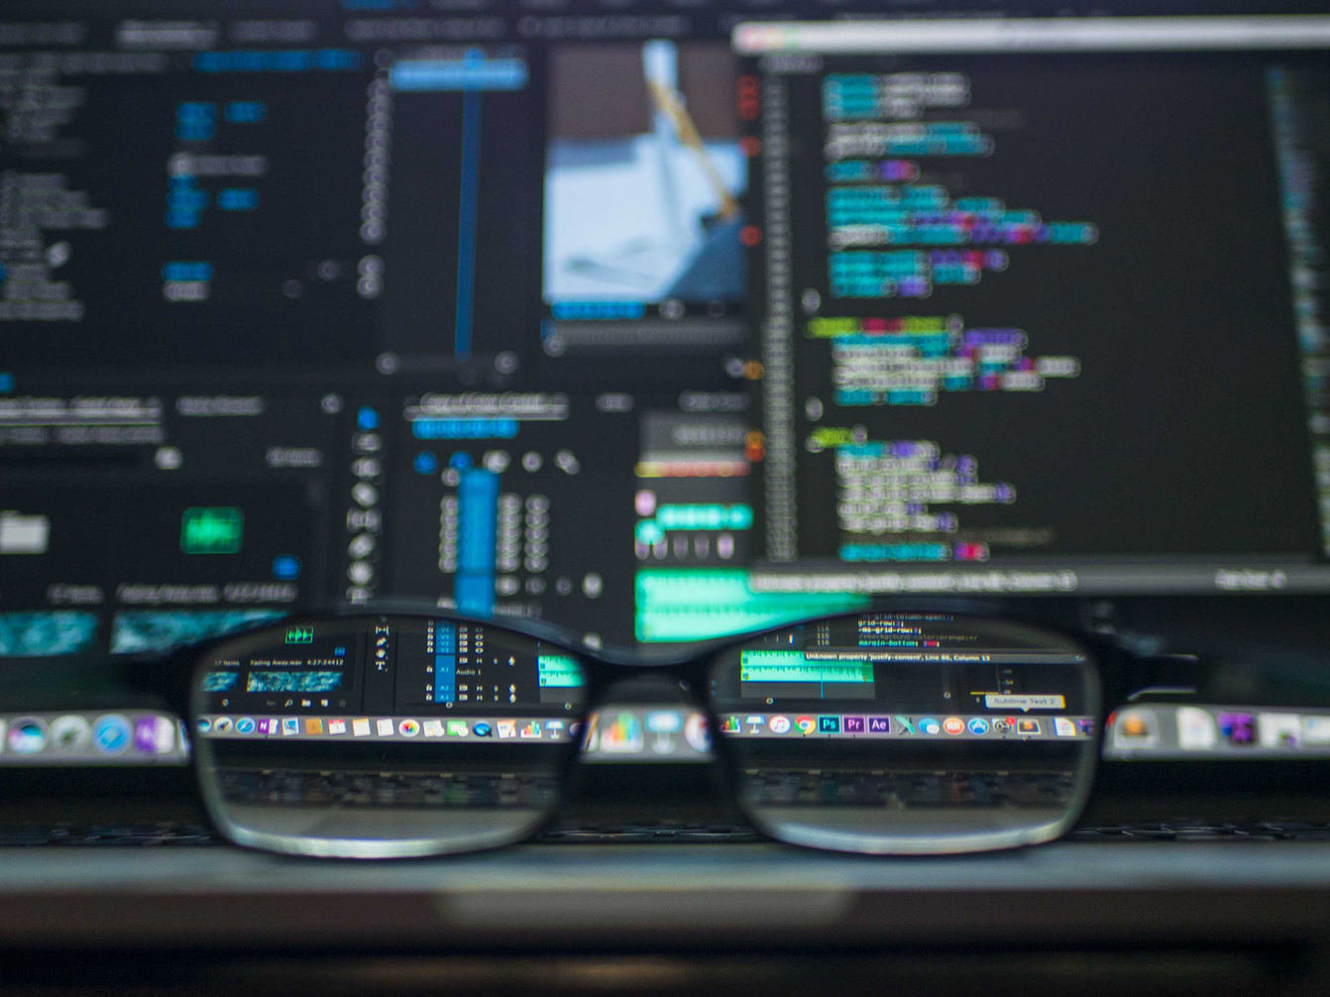

SOLUTION
We built SecureWipe, a desktop tool that permanently erases sensitive or personal files.
It overwrites every byte using military-grade algorithms (DoD/Gutmann) so data can never be recovered, and provides a verifiable Certificate of Erasure for proof.

Slide 5
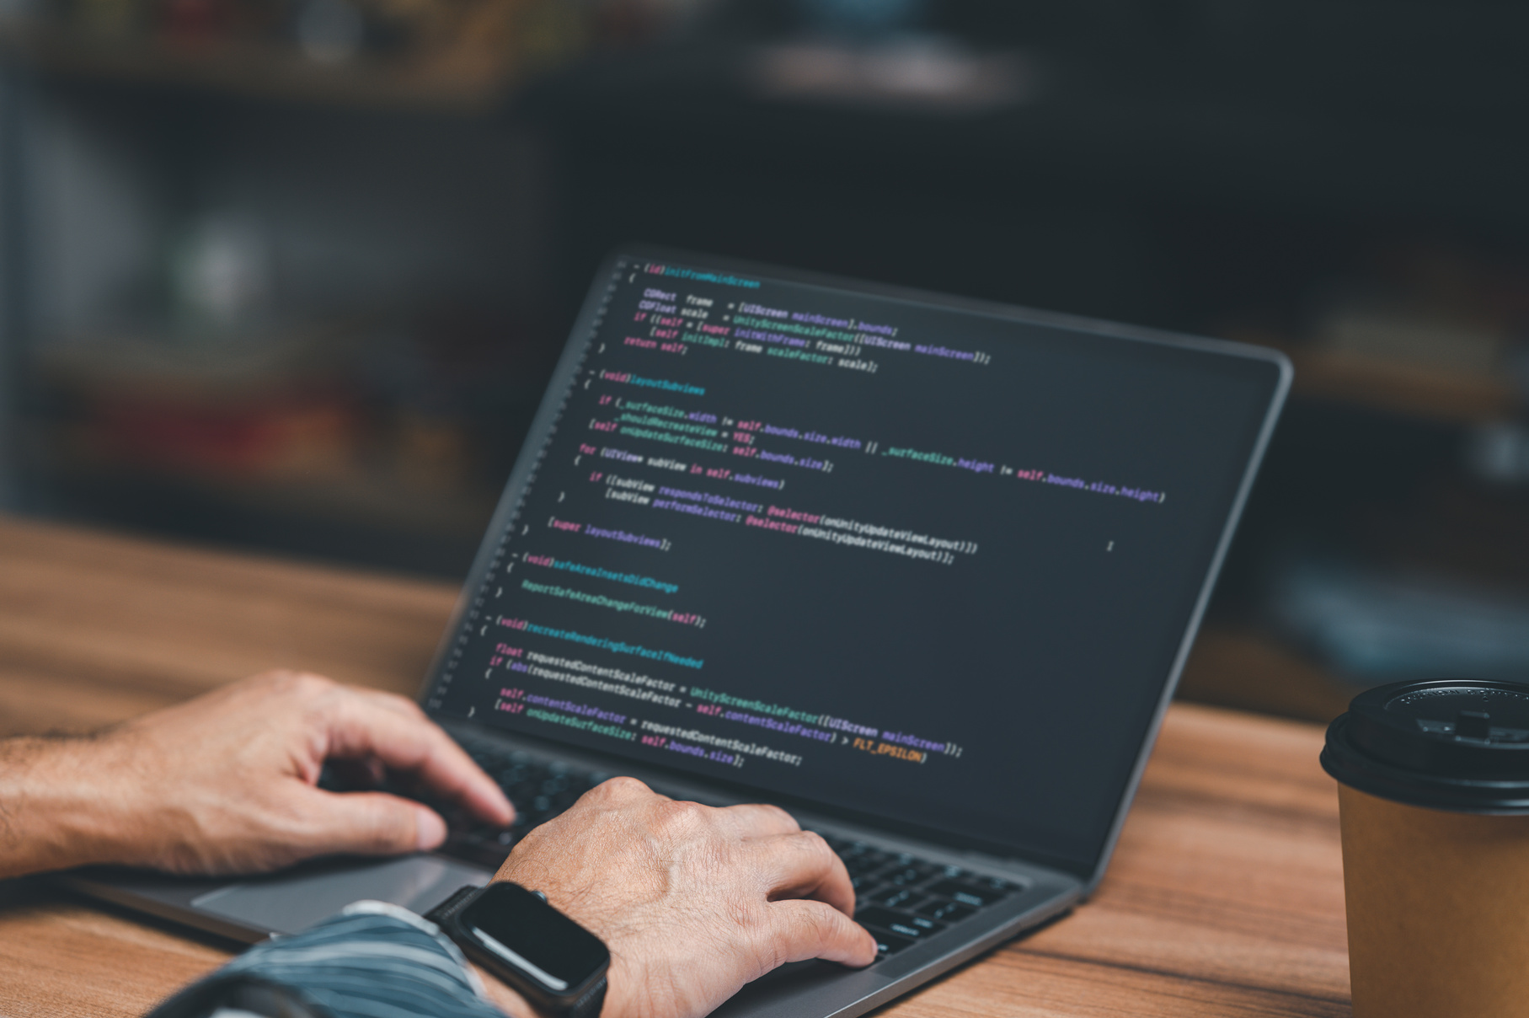
SECUREWIPE
Multi-Algorithm Wipe - DoD 5220.22-M(3-pass), Gutmann (35-pass), or simple random overwrite
Full Flexibility - Wipe single files, folders, or entire drives
Password-Protected Access- Prevents unauthorised wipes
Proof of Deletion- Auto-generates detailed log+ optional PDF certificates of Erasure
Cross-Device Ready- Works with HDDs, SSDs, USBs and other removable drives
Real Time Progress- TQDM progress bar and detailed pass-by-pass hashing

Slide 6

BENEFITS
Permanent Data Wipe Software
Overwrites every sector of the drive multiple times
Makes old files 100% unrecoverable
Works on HDDs, SSDs, USBs and whole systems
Uses AI to detect data is safe to reset or not
One-click, fast and secure – ready for personal or enterprise use
Delete once. Gone forever

Slide 7
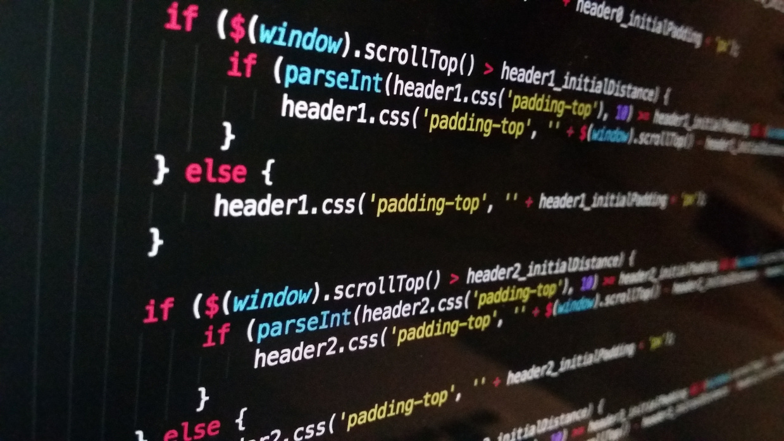
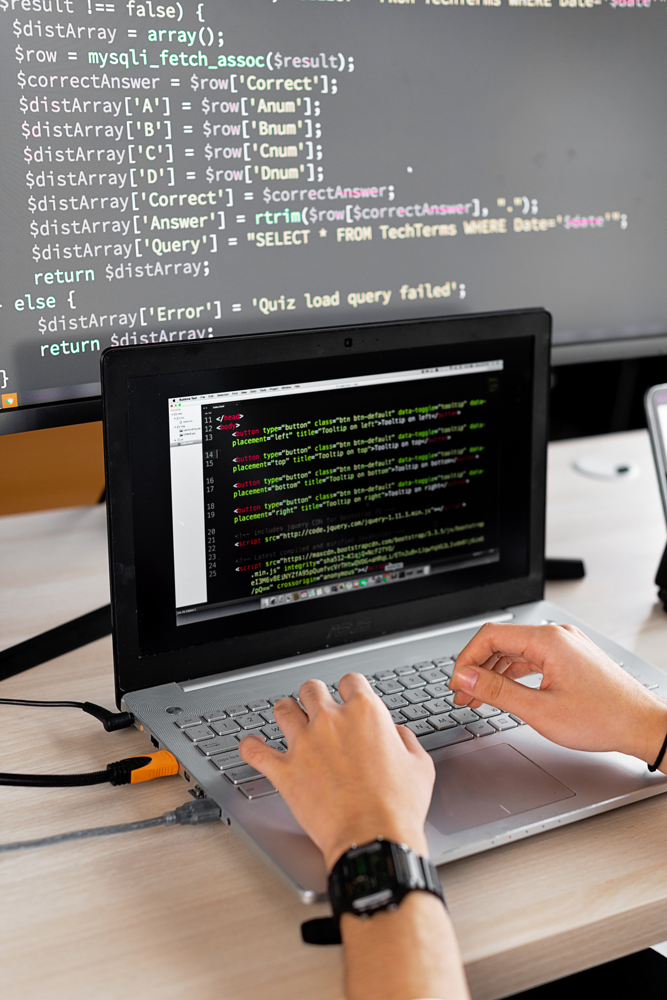
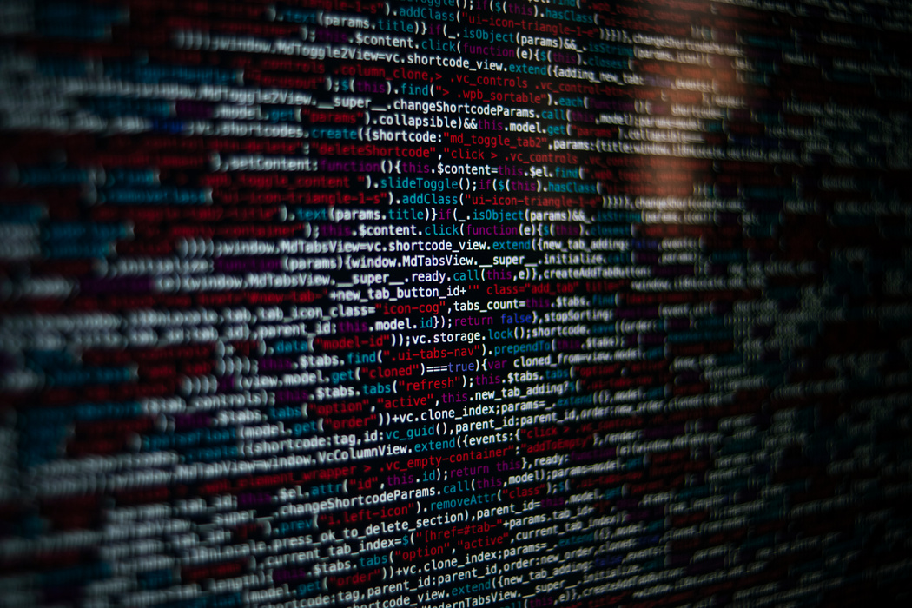
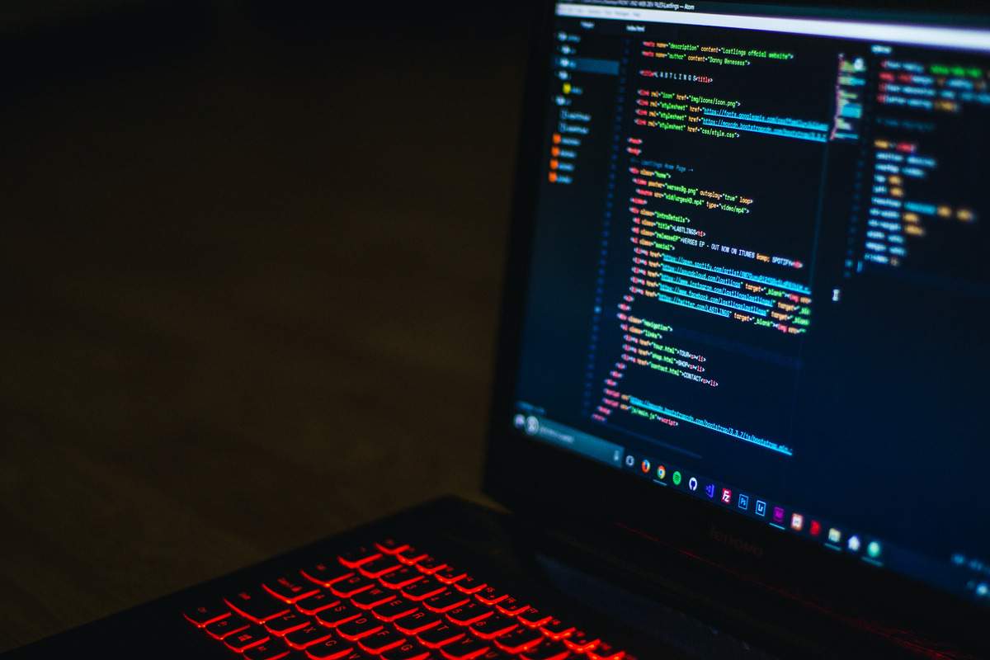
FUTURE GROWTH
We are planning to implement SecureWipe in other operating systems like macOS, Linux, etc.
Implementation of AI model which warns user whether to delete any important files or not.
Implementation of SecureWipe in bootable usb so that it is easy to remove complete data from the disk.
Using SecureWipe to completely delete data from large servers

Slide 8


THANK YOU

